Slide 1
Open Source Projects
with Python
Thomas Aglassinger
http://roskakori.at

Slide 2
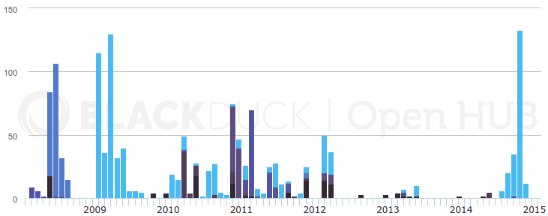
About me
1995: first open source commit
2001 (TODO?):master's degree in information processing science (Oulu, Finland)
2001: Systema Human Information Systems (Steyr, Austria)
2004: Raiffeisen Rechenzentrum (Graz, Austria)
“Casual” open source developer; Open Hub commit history:

Slide 3
Topics
Naming a project
Licensing
Version management
Simple example project
Project structure and build process
Testing
Continuous Integration
Test coverage
Code quality and analysis
Documentation
Release management
Contributions
Publishing

Slide 4
Naming a project

Slide 5
Naming a project
No http://<project>.com
No clashes with existing open source projects:
http://ivantomic.com/projects/ospnc/
Other considerations: Choosing a name for your open source projects

Slide 6
Licensing
Many licenses to choose from: http://opensource.org/licenses
Basic choices: http://choosealicense.com/
Popular:
  GNU General Public License (GPL)
  GNU Library General Public License (LGPL)
  Apache License
  MIT License
  BSD License
For our simple example program: BSD License

Slide 7
A simple example program

Slide 8
Dividemo
Command line tool to divide two integer numbers and print the result to the standard output:
$ python dividemo.py 8 2
4
$ python dividemo.py 11 3
3

Slide 9
Source Code
import argparse
import math
import sys
def divided(dividend, divisor):
return dividend // divisor # //=integer division
def main(arguments):
# Parse command line arguments.
parser = argparse.ArgumentParser(description='divide two integer numbers.')
parser.add_argument('dividend', metavar='DIVIDEND', type=int, help='number to divide')
parser.add_argument('divisor', metavar='DIVISOR', type=int,help='number to divide by')
args = parser.parse_args(arguments)
# Process arguments and print result.
result = divided(args.dividend, args.divisor)
print(result)
if __name__ == '__main__':
main(sys.argv[1:])

Slide 10
Version management

Slide 11
Version management - goals
Changes can be tracked
Other people can easily contribute
Improvements can be merged easily
Mistakes in the code can be undone by reverting to a working version

Slide 12
Popular services
https://github.com
https://bitbucket.com
http://sourceforge.net

Slide 13
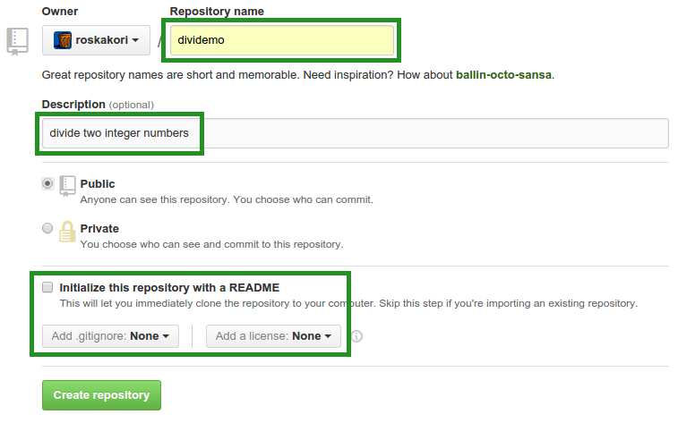
Create a project on Github

Slide 14
Project repository URL
Depend on username and project name
https://github.com/roskakori/dividemo.git

Slide 15
Project structure

Slide 16
Project structure
“5 Simple Rules For Building Great Python Packages” <http://axialcorps.com/2013/08/29/5-simple-rules-for-building-great-python-packages/>
Pyscaffold can help to putup a new project from scratch: https://pypi.python.org/pypi/pyscaffold

Slide 17
Pyscaffold
Builds a scaffold for a new project
Preconfigures helpful utilities
$ cd ~/workspace # (or something the like)
$ putup --force --description "divide two integer numbers" --url https://github.com/roskakori/dividemo --license "simple-bsd" --with-travis --with-tox dividemo

Slide 18
Connect with Github
$ git remote add origin https://github.com/roskakori/dividemo.git
$ git push -u origin master
To avoid entering the Github password on each push: https://help.github.com/articles/generating-ssh-keys/

Slide 19
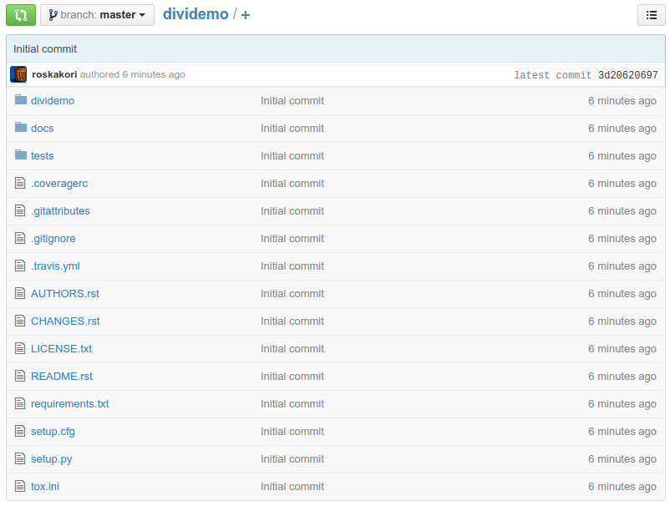
...and the result:

Slide 20
Writing a README
ReStructured Text or Markdown
Online editor: http://rst.ninjs.org/
Should contain:
  Short summary of use
  Possibly a concise example
  Reference to license, documentation, source code, issue track
For small applications: README = documentation

Slide 21
README.rst
Dividemo
========
Dividemo is a command line tool that divides two integer numbers and prints the result in the console.
Example::
$ dividemo 11 4
2
For more information, visit https://dividemo.readthedocs.org.
To get support, open an issue at https://github.com/roskakori/dividemo/issues.
The source code is available from https://github.com/roskakori/dividemo.
License
-------
Copyright (c) 2015, Thomas Aglassinger. Distributed under the BSD license. See LICENSE.txt for more information.

Slide 22
Build process

Slide 23
Setup.py (1/2)
Acts both as
  Installer
  Build tool
Supported by standard library (distutil)
Most things are are simple declarations (e.g. license, author, dependencies)
If necessary, all functions of the Python library can be used
→ no limited “scripting language” like make, ant, ...

Slide 24
Setup.py (2/2)
Has several built in commands, e.g. build and install the package
External packages can add additional commands (e.g. pip, wheel)
You can also add your own commands
→ pure Python code directly in setup.py

Slide 25
Build package
python setup.py sdist
build source distribution as *.tar.gz
python setup.py sdist --formats=zip
build source distribution as *.zip
Python setup.by bdist_wheel
build binary distribution as wheel;
requires wheel package, see https://pypi.python.org/pypi/wheel

Slide 26
requirements.txt
Describes dependencies to other Python packages that need to be installed
Simple syntax; one line per package
Example: requests >= 2.6.2
→ requires requests package, version 2.6.2 or later
Pip automatically installs packages described in requirements.txt

Slide 27
Installation
python setup.py develop
“Install” current development source code
(make it part of PYTHONPATH)
python setup.py install
Install package in current virtualenv, see https://pypi.python.org/pypi/virtualenv
sudo python setup.py install
Install package in system folders

Slide 28
Testing

Slide 29
A test program
import unittest
from dividemo import dividemo
class DividemoTest(unittest.TestCase):
def test_can_divide(self):
self.assertEqual(2, dividemo.divided(10, 5))
def test_can_print_divided(self):
dividemo.main(['10', '5'])
def test_fails_on_non_integer_divisor(self):
self.assertRaises(SystemExit, dividemo.main, ['10', 'hello'])

Slide 30
Run test suite
Requires configuration or automatic configuration by PyScaffold
python setup.py test
Runs test suite, reports result and builds HTML report about test coverage
Coverate reports is located in folder “htmlcov”.

Slide 31
Continuous integration
After each push to the version management repository, run the test suite
Travis - https://travis-ci.org/
  Github informs Travis about new push
  Travis runs tests
  If tests fail, Travis sends e-mail
  Test log is available online
Jenkins - http://jenkins-ci.org/
  Can be deployed locally
  Python setup: http://www.alexconrad.org/2011/10/jenkins-and-python.html

Slide 32
.travis.yml
language: python
sudo: true
virtualenv:
system_site_packages: true
env:
matrix:
- DISTRIB="ubuntu" PYTHON_VERSION="2.7" COVERAGE="true"
- DISTRIB="conda" PYTHON_VERSION="2.7" COVERAGE="false"
- DISTRIB="conda" PYTHON_VERSION="3.3" COVERAGE="false"
- DISTRIB="conda" PYTHON_VERSION="3.4" COVERAGE="false"
install:
- source tests/travis_install.sh
- pip install -r requirements.txt
before_script:
- git config --global user.email "roskakori@users.sourceforge.net"
- git config --global user.name "Thomas Aglassinger"
script:
- python setup.py test
after_success:
- if [[ "$COVERAGE" == "true" ]]; then coveralls || echo "failed"; fi
cache:
- apt

Slide 33

Activate travis
Visit https://travis-ci.org/profile
Click
Enable project:

Slide 34
Version numbering

Slide 35
Pythoner version numbering
Guidelines: “PEP 440 - Version Identification and Dependency Specification” https://www.python.org/dev/peps/pep-0440/
Easy but cumbersome: manual maintenance in __init__.py: __version__ = '1.2.3'

Slide 36
Version numbering with Pyscaffold
“Magic” in _version.py:
$ python
>>> from dividemo import _version
>>> _version.get_version()['version']
'0.0.post0.dev2+g8cdc4ea'

Slide 37
Advancing the version
Add a new git tag:
$ git tag -a -m "Tagged version 0.1.0." v0.1.0
$ git push --tags

Slide 38
Meanwhile...

Slide 39
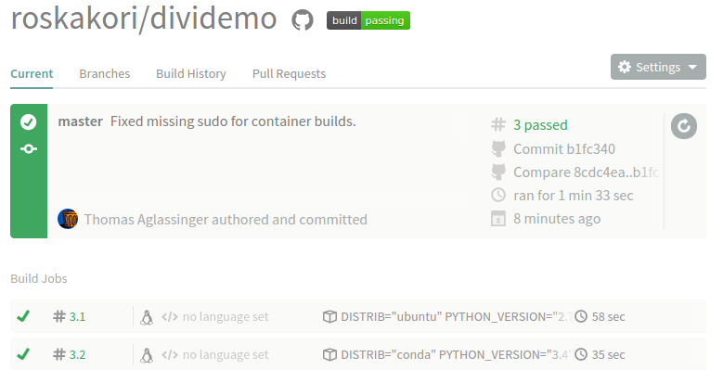
Travis finished

